Slide 1
A Front-end Execution Architecture for High Energy Efficiency
Ryota Shioya*, Masahiro Goshima†, and Hideki Ando*
* Nagoya University
† National Institute of Informatics

Slide 2
Single thread performance is important even for mobile devices
In smartphones and tablets, major developers have adopted OoO processors
A high-quality experience is required
Applications in these devices have become increasingly complex
In fact, iPhone, iPad, and many Android devices are equipped with OoO processors
e.g. iPhone6: Apple A8 (6-issue OoO processor)
But the energy efficiency is bad

Slide 3
Heterogeneous Architecture
ARM big.LITTLE consists of the combination of :
big core（OoO）
little core (in-order)
It improves energy efficiency by using little cores when high performance is not required
But, when big cores are used, a large amount of energy is still consumed

Slide 4
Why do OoO processors consume a large amount of energy?
A large amount of energy is consumed by hardware for dynamic instruction scheduling:
e.g. Issue queue (IQ), load/store queue (LSQ) ...
Such HW comprises heavily multi-ported memories
A multi-ported memory consumes energy proportionally with the square of the number of the ports
Consequently, its energy consumption is very large

Slide 5
Front-end Execution Architecture (FXA)
Goal：
Improving the energy efficiency of OoO processors
Approach：
Execute instructions in-order in the processor front-end

Slide 6
Front-end Execution Architecture (FXA)
Conventional
Register File
Issue
Queue
FU
Fetch
Rename
FU
Add the data-path to the RF and FUs to the front-end
Shrink the
issue queue
FU
FXA
Register File
Issue
Queue
FU
Fetch
Rename
FU
FU
IQ
FU
FU
Reduce the FUs in the back-end
FU
FU
FU

Slide 7
FXA has two execution units: IXU and OXU
Conventional
Register File
Issue
Queue
FU
Fetch
Rename
FU
FU
The IXU executes instructions in-order in the front-end
It functions as a filter for the OXU
FXA
Register File
Fetch
Rename
FU
FU
IQ
FU
FU
FU
In-order Ex. Unit(IXU)
OoO Ex. Unit(OXU)

Slide 8
FXA’s merit：improving energy efficiency
IXU：
The IXU consists of FUs and a bypass network
The IXU does not include the multi-ported memory
FUs can be added at low cost, and it improves performance
The IXU can execute over 50% of all instructions
OXU ：
The energy-consuming OXU can be shrunk

Slide 9
Evaluation Results
Compared with ARM Cortex A-57 (big) ,
FXA achieves:
5.7% higher IPC
17% lower energy consumption
25% improved performance/energy ratio (PER) （PER=the inverse of EDP）
Compared with ARM Cortex A-53 (little)
FXA achieves 27% improved PER

Slide 10
Outline
The basic structure and behavior of FXA
Instruction execution in the IXU
Performance and energy consumption
Evaluation

Slide 11
Basic Structure of FXA
Register File
Fetch
Rename
FU
FU
IQ
FU
FU
FU
IXU
OXU
FXA has two execution units:
1. In-order Ex. Unit (IXU)
The IXU consists of multiple-staged functional units and a bypass network
2. Out-of-order Ex. Unit (OXU)
The OXU is a shrunk OoO back-end

Slide 12
Basic Behavior of FXA
Register File
I₂
I₄
I₆
I₈
I₁₀
I₁₂
Fetch
I₀
Rename
FU
FU
IQ
FU
I₃
I₅
I₇
I₉
I₁₁
I₁₃
I₁
FU
FU
IXU
OXU
Fetched instructions flow through the front-end pipeline inc. the IXU
Without pipeline stalls, unlike in-order processors
In the IXU, an instruction is ...
executed where it can be executed, and
if it cannot be executed in the IXU, it is dispatched to the OXU
The IXU functions as a filter for the OXU
Instructions executed in the IXU are removed from the pipeline

Slide 13
Instructions executed in the IXU
The IXU can execute instructions that get all the source operands in the front-end
The source operands can be got by
reading the register file in the front-end
bypassing from instructions executed in the IXU

Slide 14
Topics
The basic structure and behavior of FXA
Instruction execution in the IXU
focusing on operand bypassing
Performance and energy consumption
Evaluation

Slide 15
IXU structure
(0, 0)
(0, 1)
FU
FU
FU
FU
(1, 0)
(1, 1)
IXU structure：
The IXU consists of multiple-staged functional units and a bypass network
e.g. 2-width x 2-stage IXU

Slide 16
Instruction execution in the IXU
(0, 0)
(0, 1)
FU
FU
I₀ :
B
=
A
+
1
I₁ :
C
=
B
+
1
I₂ :
D
=
C
+
1
I₃ :
E
=
D
+
1
FU
FU
(1, 0)
(1, 1)
Describe the behavior of the IXU using the pseudo code
including the serially dependent instructions from I0 to I3
They are integer instructions with 1-cycle latency

Slide 17
Cycle-1 Behavior
A
(0, 0)
(0, 1)
B
FU
FU
I₀ :
B
=
A
+
1
I₀: B=A+1
I₁ :
C
=
B
+
1
I₂ :
D
=
C
+
1
I₃ :
E
=
D
+
1
FU
FU
(1, 0)
(1, 1)
I₁: C=B+1
I0 and I1 are fed to the first stage.
The operand A of I0 has been read from the RF
I0 is executed on FU(0,0)
I1 has not yet got dependent B, and goes through as NOP

Slide 18
Cycle-1 Behavior
(0, 0)
(0, 1)
B
FU
FU
I₀ :
B
=
A
+
1
I₂: D=C+1
I₀: B=A+1
I₁ :
C
=
B
+
1
I₂ :
D
=
C
+
1
I₃ :
E
=
D
+
1
FU
FU
(1, 0)
(1, 1)
I₃: E=D+1
I₁: C=B+1
The execution result B is fed to FU(1,1) for executing I1 in the next cycle
The instructions are fed to the next stage

Slide 19
Cycle-2 Behavior
(0, 0)
(0, 1)
FU
FU
I₀ :
B
=
A
+
1
I₂: D=C+1
I₀: B=A+1
I₁ :
C
=
B
+
1
I₂ :
D
=
C
+
1
B
C
I₃ :
E
=
D
+
1
FU
FU
(1, 0)
(1, 1)
I₃: E=D+1
I₁: C=B+1
On FU(1,1), I1 is executed
Multiple staged IXU executes instructions in the same fetch group such as I0 and I1
I2 and I3 are fed to the first stage

Slide 20
Cycle-2 Behavior
(0, 0)
(0, 1)
FU
FU
I₀ :
B
=
A
+
1
I₂: D=C+1
I₀: B=A+1
I₁ :
C
=
B
+
1
I₂ :
D
=
C
+
1
C
C
I₃ :
E
=
D
+
1
FU
FU
(1, 0)
(1, 1)
I₃: E=D+1
I₁: C=B+1
The execution result C is fed to FU(0,1)
C fed to FU(0,1) is for executing I2 in the next cycle
The instructions are fed to the next stage

Slide 21
Cycle-3 Behavior
(0, 0)
(0, 1)
C
FU
FU
D
I₀ :
B
=
A
+
1
I₂: D=C+1
I₁ :
C
=
B
+
1
I₂ :
D
=
C
+
1
I₃ :
E
=
D
+
1
FU
FU
(1, 0)
(1, 1)
I₃: E=D+1
On FU(0,1), I2 is executed
Because source C was fed from I1

Slide 22
Instructions not executed in the IXU
(0, 0)
(0, 1)
FU
FU
D
I₀ :
B
=
A
+
1
I₂: D=C+1
I₁ :
C
=
B
+
1
I₂ :
D
=
C
+
1
I₃ :
E
=
D
+
1
FU
FU
(1, 0)
(1, 1)
I₃: E=D+1
I3 has not yet got dependent D, and goes through as NOP
I3 is dispatched to the OXU

Slide 23
Instructions executed in the IXU
The bypassing increases instructions executed in the IXU
The ratio of executed instructions
whose operands got from the RF: 5.5%
whose operands got through bypassing: over 50%
In general, more instructions are executed
when the IXU has more stages
when the distance to producer is longer
e.g. If I3 is distant from I2, I3 is executed

Slide 24
Behavior when executing other instruction types in IXU
Branch
Branches are executed similarly to INT instructions
FP
FP instructions are not executed in the IXU
FP instructions have long latency, and it prolongs the pipeline-length of the IXU too much
Load/Store
Load/store instructions are executed in the IXU with the arbitration of D-Cache/LSQ between the IXU and the OXU
If the ports are not acquired, instructions go through as NOP in the IXU

Slide 25
Topics
The basic structure and behavior of FXA
Instruction execution in the IXU
Performance and energy consumption
Evaluation

Slide 26
Performance Improvement of FXA
The added FUs to the IXU improve performance
The IXU does not include the multi-ported memory, FUs can be added with low energy overhead
It virtually widens the issue-width
e.g. In our evaluation,
Conv. OoO: executes up to 4 instructions per cycle
FXA: executes up to 5 instructions per cycle
3（IXU）+ 2（OXU）
It improves IPC by 5.7%

Slide 27
Energy Consumption of FXA
FXA reduces the energy consumption compared with the conventional OoO processors
Increased energy consumption for the IXU: SMALL
IXU
RF
Decreased energy consumption of the OXU: BIG
Issue Queue
LSQ

Slide 28
The increased energy consumption for the IXU is small
In the IXU, the energy is mainly consumed by the FUs
Dynamic energy consumption is not changed significantly
Instructions are executed once on any FUs.
Energy consumer is moved from the OXU to the IXU
Static energy consumption is slightly increased
The number of FUs is increased
INT FUs are very small and it does not cause a problem

Slide 29
The energy consumption of the RF is not changed significantly
Conventional
Register File
Issue
Queue
FU
Fetch
Rename
The data-path to the IXU is added, but that to the OXU is reduced
The number of the ports is same
FU
FU
Register File
FXA
Fetch
Rename
FU
FU
IQ
FU
FU
FU
In-order Ex. Unit(IXU)
OoO Ex. Unit(OXU)

Slide 30
Energy Consumption of OXU
The energy consumption of the IQ and LSQ is reduced
Issue Queue
1)width, 2)capacity, and 3)access num are cut in half
The energy consumption is reduced by 86%
Load/store queue
When store instructions are executed in the IXU, order-violation detection is omitted
Store instructions are executed in-order to successor-load instructions in the IXU, and order violation must not occur

Slide 31
Topics
The basic structure and behavior of FXA
Instruction execution in the IXU
Performance and energy consumption
Evaluation

Slide 32
Evaluation Environment
IPC
In-house cycle accurate simulator
Energy Consumption
McPAT (22nm tech.)
Benchmark programs
All 29 programs in SPECCPU 2006
Processor Configurations
Major micro-architectural parameters are based on ARM Cortex-A57/A53 (big.LITTLE)

Slide 33
Evaluation Models
BIG：
Baseline OoO processor based on Cortex-A57
HALF：
In BIG, its issue width and IQ capacity are cut in half
LITTLE：
In-order processor based on Cortex-A53
BIG+FX：
FXA with the OXU of the BIG model
HALF+FX：
FXA with the OXU of the HALF model
The IXU has 3 stages

Slide 34
Baseline Configuration
 | BIG | HALF | LITTLE
type | out-of-order | ← | in-order
fetch width | 3 inst. | ← | 2 inst.
issue width | 4 inst. | 2 inst. | 2 inst.
IQ | 64 entries | 32 entries | N/A
ROB | 128 entries | ← | N/A
functional unit | int:2, fp:2, mem:2 | ← | int:2, fp:1, mem:1
L1 I-Cache | 48 KB, 3 cycles | ← | ←
L1 D-Cache | 32 KB, 3 cycles | ← | ←
L2 Cache | 512 KB, 10 cycles | ← | ←
main memory | 200 cycles | ← | ←
In the FXA models, the IXU is added to BIG and HALF

Slide 35
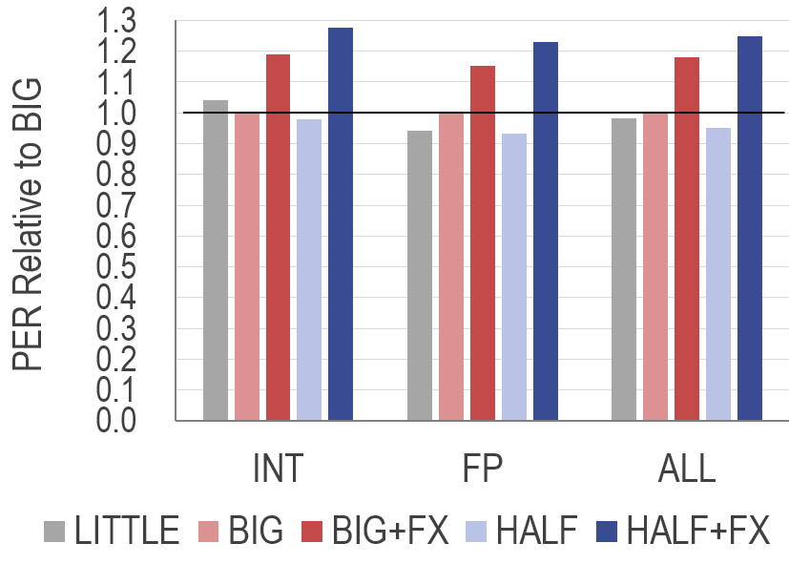
Relative Performance/Energy Ratio （The inverse of EDP） All PERs are normalized by that of BIG
HALF+FX improves the PER by 25% compared with BIG
Because HALF+FX improves the performance and reduces the energy consumption

Slide 36
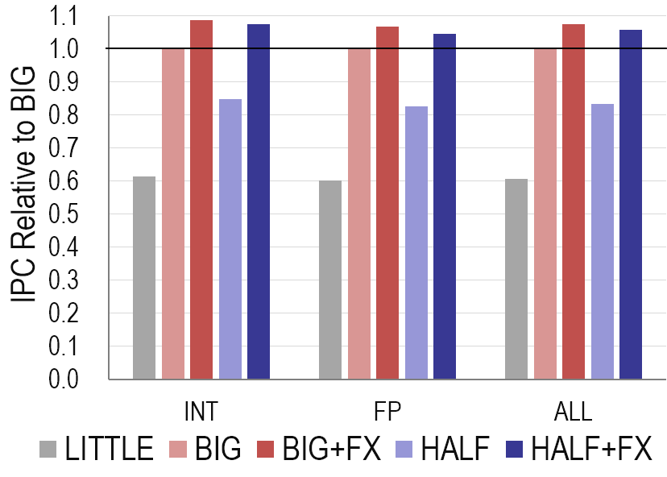
Relative IPC in SPECCPU 2006 All IPCs are normalized by those of BIG
HALF+FX improves the IPC by 5.7%
The IXU can execute over 50% of instructions

Slide 37
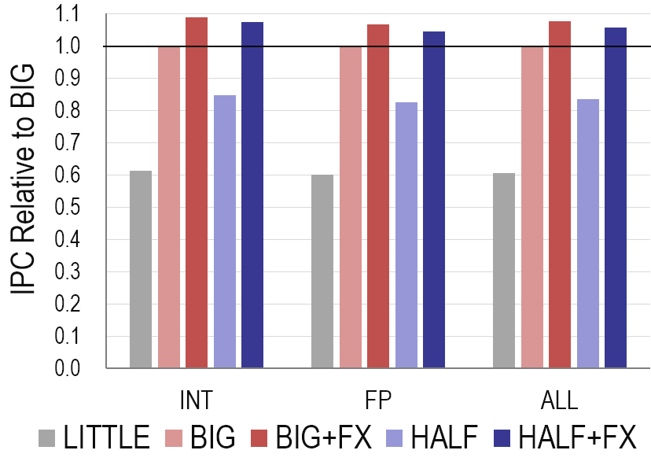
Relative IPC in SPECCPU 2006 All IPCs are normalized by those of BIG
In HALF, IPC is degraded by 16%
The issue width and IQ capacity are cut in half
HALF+FX has the OXU of HALF, but it improves the IPC significantly

Slide 38
Relative IPC in SPECCPU 2006 All IPCs are normalized by those of BIG
BIG+FX and HALF+FX show similar IPCs
The IXU in BIG+FX executes sufficient instructions
The shrunk OXU in HALF+FX does not affect the performance

Slide 39
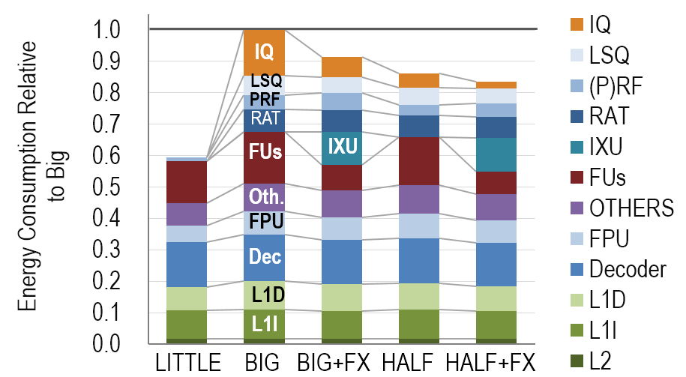
Relative energy consumption All Energies are normalized by that of BIG
Compared with BIG, HALF+FX reduces the energy consumption by 17%
The energy consumption of the IQ and LSQ is reduced by 86% and 23%, respectively
HALF+FX improves the IPC, so the static energy consumption is reduced
The increased energy consumption for the IXU is negligible

Slide 40
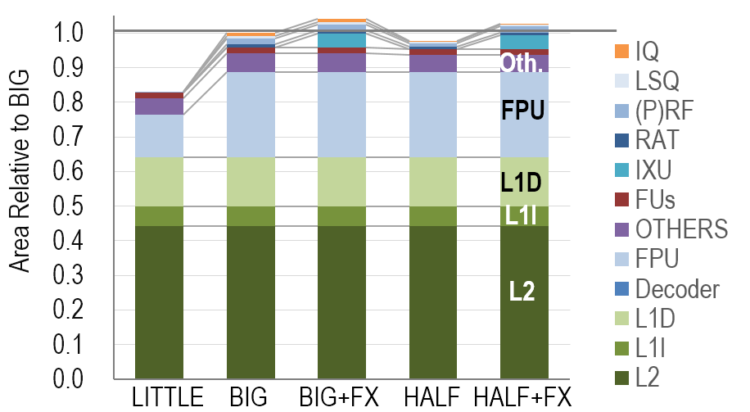
Relative circuit area All areas are normalized by that of BIG
Compared with BIG, HALF+FX increases the area by 2.7%,
Because the IXU is added
The IXU is significantly smaller than the whole processor

Slide 41
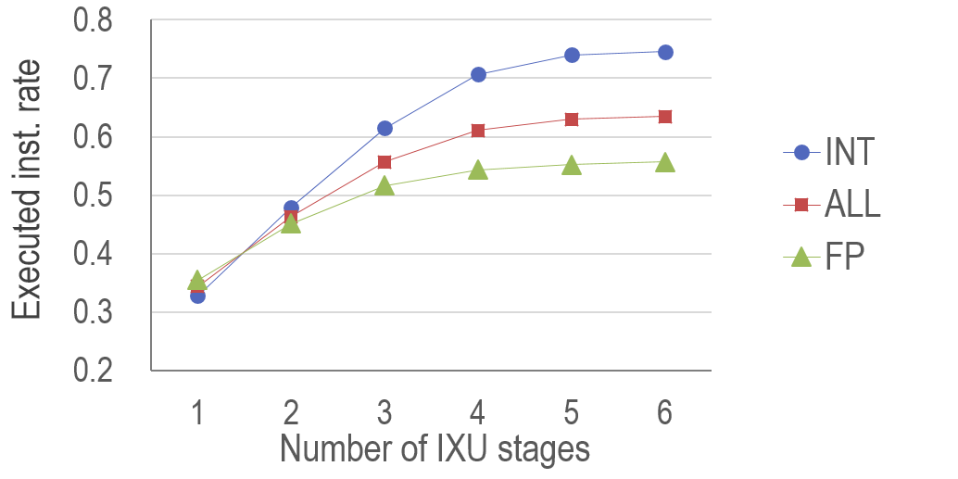
Executed instructions rate in the IXU while varying the FUs depth
The execution rate increases with the increase in the depth
The increase is saturated at 4-stage
The FXA models were evaluated with the 3-stage IXU
for mitigating the complexity of bypassing
The 3-stage IXU executes 54% instructions

Slide 42
Conclusion
OoO processors are fast, but their energy efficiency is low
We propose Front-end Execution Architecture (FXA)
For improving the energy efficiency of OoO processors
Add the IXU that executes instructions in-order in the front-end
The multiple-staged IXU can execute and filter over 50% instructions with high efficiency
Shrinks the OXU and reduces the energy consumption
Compared with Cortex A-57 (big), FXA achieves
5.7% higher IPC and 17% lower energy consumption
25% higher performance energy ratio(=the inverse of EDP)

