Slide 1
Register Cache System not for Latency Reduction Purpose
Ryota Shioya, Kazuo Horio,
Masahiro Goshima, and Shuichi Sakai
The University of Tokyo
Notes:
Thank you chairman.
(My name is Ryota Shioya.
Today I would like to talk about Register Cache System not for Latency Reduction Purpose.

Slide 2
Outline of research
The area of register files of OoO superscalar processors has been increasing
It is comparable to that of an L1 data cache
A large RF causes many problems
Area, complexity, latency, energy, and heat …
A register cache was proposed to solve these problems
But … miss penalties most likely degrade IPC
We solve the problems with a “not fast” register cache
Our method is faster than methods with a “fast” register caches
Circuit area is reduced to 24.9% with only 2.1% IPC degradation
Notes:
This is an outline of today’s presentation.
Recently, the area of register files of OoO superscalar processors has been increasing.
And it is comparable to that of L1 data cache.
A large RF causes many problems.
Especially, energy consumption and heat are serious.
A register cache was proposed to solve these problems of the RF.
But miss penalties most likely degrade IPC.
We solve the problems with a “not fast” register cache
Our method is faster than methods with a “fast” register cache
Our evaluations show a circuit area is reduced to 24.9%, and
IPC degradation is no more than 2.1%

Slide 3
Background : The increase in the circuit area of register files
The area of register files of OoO superscalar processors has been increasing
The increase in the number of entries
The required entry number of RFs is proportional to in-flight instructions
Multi-threading requires a number of entries that are proportional to the thread number
The increase in the number of ports
A register file consists of a highly ported RAM
The area of a RAM is proportional to the square of the port number
Notes:
Now let me introduce the background
Recently, the area of register files of OoO superscalar processor has been increasing.
There are two reasons for this.
That is the increase in entries and ports of RFs.
For achieving high IPC, many entries are required.
Multi-threading also requires many entries.
The second reason is the increase in the number of ports.
A register file consists of a highly ported RAM.
The area of a RAM is proportional to the square of the port number.

Slide 4
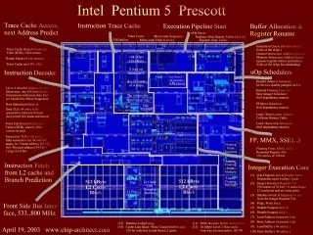
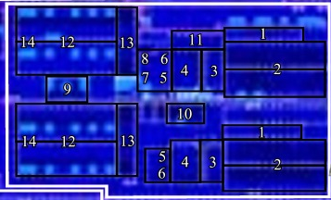
RF area is comparable to that of an L1 data cache Ex: Integer execution core of Pentium4
L1 Data cache
16KB 1 read/1 write
Register file
64 bits 144 entries 6 read/3 write
(double pumped)
（ from http://www.chip-architect.com）
Notes:
As a result of the increases, RF area is comparable to that of an L1 data cache.
This is a photograph of an integer execution core of a Pentium4.
The left yellow rectangles are L1 data caches.
The right red rectangles are register files.
This photograph shows these areas are almost the same.
//This holds true for more recent processor cores

Slide 5
Problems of large register files
The increase of energy consumption and heat from it
The energy consumption of a RAM is proportional to its area
A region including a RF is a hot spot in a core
It limits clock frequency
The increase in access latency
Access latency of a RF is also comparable to that of an L1D$
A RF is pipelined
The increase in bypass network complexity
A deeper pipeline decreases IPC
Prediction miss penalties
Stalling due to resource shortage
Notes:
A large register file causes many problems.
These two problems are important.
First, energy consumption and heat from it.
The energy consumption of a RAM is proportional to its area.
A region including a RF is a hot spot of a core,
So it limit the clock frequency
Second, the increase in access latency
Access latency of a RF is also comparable to that of L1D$
So, a RF is pipelined similar to L1D$.
Pipelining a RF leads to the increase in bypass network complexity
And a deeper pipeline usually decrease IPC.

Slide 6
Register cache
proposed to solve the problems of a large RF
Register cache（RC）
A small & fast buffer
It caches values in a main register file（MRF）
Miss penalties of a RC most likely degrade IPC
Ex. It degrades IPC by 20.9% ( 8 entry RC system )
Notes:
A register cache is proposed to solve these problems of a large RF.
The RC is a small and fast buffer and it caches values in the main register file.
However, miss penalties of a RC most likely degrade IPC.
For example, our evaluations show that IPC degradation by RC misses is 20.9%.

Slide 7
Our proposal
Research goal :
Reducing the circuit area of a RF
We achieve this with a “not fast” register cache
Our RC does not reduce latency
Our method is faster than methods with “fast” register caches
Notes:
Our goal of the research is to reduce the circuit area of a register file.
We achieve this with a “not fast” register cache.
Our RC does not reduce latency,
but it is faster than methods with “fast” register caches.
Our Evaluation results shows that the circuit area is reduced to 24.9%, and
IPC degradation is no more than 2.1%
Shifts RC miss penalties to branch miss prediction penalties

Slide 8
Our proposal
Usually, the definition of a cache is “cache is a fast one”
Text books
Wikipedia
You may think …
In this definition
Our proposal is not a cache
One may think …
Why a RC that does not reduce latency works
A not fast cache is usually meaningless
Why a not fast cache overcomes a fast cache
Notes:
Usually, the definition of a cache is “cache is a fast one”.
I found this in some text books and wikipedia.
And you may think so too.
In this definition, our proposal is not a cache.
One may think,
Why a RC that does not reduce latency works?
A not fast cache is usually meaningless
Why a not fast cache overcomes a fast cache?
In the following , I will talk about them.

Slide 9
Outline
Conventional method : LORCS : Latency-Oriented Register Cache System
Our proposal： NORCS : Non-latency-Oriented Register Cache System
Details of NORCS
Evaluation
Notes:
This is the outline of the following section.
First, I will talk about LORCS. This is a conventional method that solves the problems of a large RF.
The second topic is NORCS. This is our proposal.
Then, I will talk about detailed topics about NORCS.
Finally, I will show evaluations of systems.

Slide 10
Register cache
Register cache (RC)
A RC is a small and fast buffer
caches values in the main register file（MRF）
Notes:
A RC is a small and fast buffer
and it caches values in the main register file.

Slide 11
Register cache system
Out of pipelines
Main Register File
Write Buffer
Register cache
Instruction
Window
ALUs
A register cache system refers to a system that includes the followings :
Register cache
Main register file
Pipeline stages
Notes:
A register cache system refers to a system that includes the followings.
A register cache, A main register file, and pipeline stages.
Note that a MRF is placed out of pipelines, it is accessed only on RC miss.

Slide 12
LORCS : Latency-Oriented-Register Cache System
Two different register cache system
Latency-Oriented : Conventional method
Non-Latency-Oriented : Our proposal
LORCS : Latency-Oriented-Register Cache System
A conventional RC system is referred to as it in order to distinguish it from our proposal
Usually, the “Register Cache” refers this
Notes:
I will talk about two different register cache systems.
latency oriented one, it is a conventional method
non-latency oriented one, it is our proposal
A conventional RC system is Latency-Oriented-Register Cache System, we call it LORCS.
We call so in order to distinguish from our proposal.
Usually the RC refers this.

Slide 13
LORCS : Latency-Oriented-Register Cache System
Pipeline that assumes hit
All instructions are scheduled assuming their operands will hit
If all operands hit,
It is equivalent to a system with a 1-cycle latency RF
On the RC miss, pipeline is stalled (miss penalty)
This pipeline is the same as a general data cache
Notes:
LORCS has a pipeline that assumes hit.
In LORCS, All instructions are scheduled assuming their operands will hit
If all operands hits , LORCS is equivalent to a system with a one cycle latency RF.
On the RC miss, pipeline is stalled.
This pipeline is the same as a general data cache.

Slide 14
Behavior of LORCS
cycle
I₁ :
IS
CR
EX
CW
CR
I₂ :
IS
EX
RR
CW
CR
RR
CR
I₃ :
IS
CR
EX
CW
Stall
Miss
CR
I₄ :
IS
CR
EX
CW
CR
I₅ :
IS
CR
EX
CW
CR
On RC miss, the processor backend is stalled
MRF is accessed in the meantime
CR | RC Read
CW | RC Write
RR | MRF Read
CR
CW
RR
Notes:
This figure shows behavior of the LORCS
IS is instruction issue, CR is RC read, EX is execution, CW is RC write.
The CR and RR stages are horizontally divided into 2.
It represents two source operands.
When all operands hit a RC, instructions are executed in this way.
This is equivalent to behavior of a 1 cycle latency register file.
Next, I will talk about behavior on miss.
The cycle time is progressed, and now an operand of instruction I2 missed the RC.
The processor backend is stalled and a MRF is accessed in the meantime.
This is a miss penalty.

Slide 15
Consideration of RC miss penalties
The processor backend is stalled on RC misses
OoO superscalar processors can selectively delay instructions with long latency
One may think that the same can be used for RC misses
Selective delay of instructions on RC misses is difficult
Non-re-schedulability of a pipeline
Notes:
The processor backend is stalled on RC misses
Usually, OoO superscalar processors can selectively delay instructions with long latency
One may think that the same can be done on RC misses.
However, selective delay of instructions on RC misses is difficult
This is because of Non-re-schedulability of a pipeline.

Slide 16
Non-re-schedulability of a pipeline
Out of pipelines
Main Register File
I0 misses RC
Write Buffer
Register cache
Instruction Window
I0
I2
I4
ALUs
I1
I3
I5
Instructions cannot be re-scheduled in pipelines
Notes:
I will talk about this by using this figure.
This is a backend pipeline of LORCS.
Now I0 and I1 are issued from the instruction window.
…
I0 misses the RC.
At this timing, if you want to delay I0 selectively,
on the next cycle, there is no place for the following I2.
Moreover, if I3 depends on I0,
I3 must be delayed and the processor must detect this.
This means an additional scheduling logic and instruction window are required here,
If you want to delay instructions selectively.
But it is unrealistic.

Slide 17
Purposes of LORCS
Reducing latency：
In the ideal case, it can solve all the problems of pipelined RFs
Reducing prediction miss penalties
Releasing resources earlier
Simplifies bypass network
Reducing ports of a MRF
Notes:
purposes of the LORCS are reducing latency and reducing ports of a MRF.
First, In the ideal case, it can solve all the problems of pipelined RFs.
It reduces prediction miss penalty,
releases resources earlier,
simplify bypass network.

Slide 18
Reducing ports of a MRF
Register file
Main Register file
Register cache
ALUs
ALUs
Only operands that caused RC misses access MRF
requires only a few ports
Reducing the area of the MRF
RAM area is proportional to the square of the port number
Notes:
Second, it can reduce the ports of a MRF.
Only operands that caused RC misses access a MRF,
Therefore a MRF has a few ports.
The area of a RAM is proportional to the square of the port number,
So it reduces the area of the MRF greatly.

Slide 19
Outline
Conventional method : LORCS : Latency-Oriented Register Cache System
Our proposal： NORCS : Non-latency-Oriented Register Cache System
Details of NORCS
Evaluation
Notes:
Next, I talk about our proposal NORCS.

Slide 20
NORCS : Non-latency-Oriented Register Cache System
NORCS also consists of
RC, MRF, and Pipeline stages
It has a similar structure to LORCS
It can reduce the area of a MRF by a similar way of LORCS
NORCS is much faster than LORCS
Important difference
NORCS has stages accessing a MRF
Notes:
NORCS : Non-latency-Oriented Register Cache System
also consists of a RC, a MRF, and pipeline stages.
It has a similar structure to LORCS.
and it can reduce the area of a MRF by a similar way of LORCS.
Hwevere, NORCS is much faster than LORCS
An important difference is that NORCS has stages accessing a MRF.

Slide 21
NORCS has stages accessing the MRF
Out of pipelines
MRF
RC
IW
LORCS:
ALUs
MRF
RC
IW
NORCS:
ALUs
The difference is quite small, but it makes a great difference to the performance
Notes:
These figures show block diagrams of LORCS and NORCS.
The upper half is LORCS
The lower half is NORCS, our proposal
Both consist of a RC, a MRF, and pipelines.
An important difference is that NORCS has stages accessing the MRF,
But LORCS doesn’t have them.
The MRF is placed out of the pipelines.
The difference in the logic is quite small,
but it makes a great difference to the performance

Slide 22
Pipeline of NORCS
NORCS has stages to access the MRF
Pipeline that assumes miss：
All instructions wait as if it had missed regardless of hit / miss
It is a cache, but
does not make processor fast
Notes:
NORCS has stages to access the MRF,
which means that
NORCS has a pipeline that assumes a RC miss.
All instructions wait as if it had missed regardless of hit /miss.
So, it is a cache, but it does not make processor fast.

Slide 23
Pipeline that assumes miss
I₁ :
cycle
IS
CR
RR
RR
EX
CW
CR
RR
RR
IS
CR
RR
RR
RR
I₂ :
RR
EX
CW
CR
RR
RR
RC hit
IS
CR
RR
RR
EX
CW
I₃ :
CR
RR
RR
I₄ :
RC miss
IS
CR
RR
RR
EX
CW
RC hit
CR
RR
RR
I₅ :
IS
CR
RR
RR
EX
CW
CR
RR
RR
RC hit
CR | RC Read
CW | RC Write
RR | MRF Read
：accesses MRF
CR
RR
：does not access MRF
CW
RR
Pipeline of NORCS is not stalled only on RC misses
The pipeline is stalled when the ports of the MRF are short.
Notes:
This is behavior of NORCS.
All the operands of I1 hit the RC.
on the following stages, the operands do not access the MRF.
When one of the operands of the I2 misses the register cache,
on the following stages, the operand accesses the MRF.
All the operands of I3 and I4 hit the RC.
Their operands don’t access the MRF.
This figure shows the pipeline of NORCS is not stalled only on the RC misses.
The pipeline is stalled when the ports of the MRF are short.

Slide 24
Pipeline disturbance
Conditions of pipeline stalls :
LORCS :
If one ore more register cache misses occur at a single cycle
NORCS:
If RC misses occur more than MRF read ports at a single cycle
The MRF is accessed in the meantime
This probability is very small
Ex. 1.0% in NORCS with 16 entries RC
Notes:
Conditions of pipeline stalls are summarized here.
In LORCS, if one or more register cache misses occur, the pipeline is stalled.
On the other hand, in NORCS,
If RC misses occur more than MRF read ports, the pipeline is stalled.
This probability is very small.
For example, in NORCS with 16 entries RC, this is 1.0%

Slide 25
Outline
Conventional method : LORCS : Latency-Oriented Register Cache System
Our proposal： NORCS : Non-latency-Oriented Register Cache System
Details of NORCS
Why NORCS can work
Why NORCS is faster than LORCS
Evaluation
Notes:
Now, I will talk about details of NORCS.
I will talk about
Why NORCS can work and
Why NORCS is faster than LORCS

Slide 26
Why NORCS can work
A pipeline of NORCS can work only for a RC
A not fast cache is meaningless in general data caches
Explain this by :
data flow graph (DFG)
dependencies
There are two types of dependencies
“Value – value” dependency
“Via – Index” dependency
Notes:
A pipeline of NORCS can work only for a RC.
A not fast cache is meaningless in general data caches.
I try to explain this by using
Data flow graph and two types of dependencies.
There are two types of dependencies.
“Value – value” dependency and
“Via – Index” dependency

Slide 27
Value – value dependency
Data cache
A dependency from a store to a dependent load instruction
The increase in the latency possibly heightens the DFG
Cache Latency
store [a] ← r1
AC
L1
L1
load r1 ← [a]
AC
L1
L1
Height of DFG
store [a] ← r1
AC
L1
L1
L1
load r1 ← [a]
AC
L1
L1
L1
Height of DFG
Notes:
In a data cache,
A Value – value dependency means a dependency
from a store to a dependent load instruction.
The increase in the latency possibly heightens the DFG like this.

Slide 28
Value – value dependency
Data cache
store [a] ← r1
AC
L1
L1
L1
load r1 ← [a]
AC
L1
L1
L1
Height of DFG
Register cache
RC latency is independent of the DFG height
mov r1 ← A
EX
CW
CW
CW
add r2 ← r1 + B
EX
CR
CR
CR
Height of DFG
Bypass net can pass the data
Notes:
On the other hand,
In a register cache,
Since the bypass network can immediately pass the data,
the register cache latency is independent of the height of DFG.

Slide 29
Via index dependency
Data cache
A dependency from an instruction to a dependent load instruction
Ex. : Pointer chasing in a linked list
load r1 ← [a]
AC
L1
L1
L1
load r2 ← [r1]
AC
L1
L1
L1
Height of DFG
Register cache
There are no dependencies from execution results to register number
The RC latency is independent of the height of DFG
Notes:
Next, via index dependency.
In a data cache,
It means a dependency from an instruction to a dependent load instruction.
Typical example of this is pointer chasing in a linked list.
The increase in the cache latency also heightens the DFG
On the other hand,
In a register cache
There are no dependencies from execution results to register number
The register cache latency is independent of the height of DFG
This is a reason why the pipeline of NORCS can work only for a RC.

Slide 30
Why NORCS is faster than LORCS
Why NORCS is faster than LORCS
NORCS : always waits
LORCS : waits only when needed
Because :
LORCS suffers from RC miss penalties with high probability
Stalls occur more frequently than RC miss of each operand
NORCS can avoid these penalties
Can shift RC miss penalties to branch miss prediction penalties with low probability
Notes:
The second topic is
Why NORCS is faster than LORCS.
NORCS always waits, but LORCS waits only when needed.
Howevere, NORCS is faster than LORCS.
This is because
LORCS suffers from RC miss penalties with high probability.
Stalls occur more frequently than RC miss of each operand.
NORCS can avoid these penalties.
NORCS can shift RC miss penalties to branch miss prediction penalties with low probability.
I will talk about these in the following.

Slide 31
Stalls occur more frequently than RC miss of each operand
In LORCS, a pipeline is stalled when：
One or more register cache misses occur at a single cycle
Ex.： SPEC CPUINT 2006 456.hmmer / 32 entries RC
RC miss rate : 5.8% ( = hit rate is 94.2%)
Source operands per cycle are 2.49
Probability that all operands hit
0.942^{2.49}≒0.86
Probability to stall (any of operands miss)
1 - 0.942^{2.49} ≒0.14 (14%)
Our evaluation shows more than 10% IPC degradation in this benchmark
Notes:
In LORCS, a pipeline is stalled when：
One or more register cache misses occur at a single cycle
For example, in a case of SPEC CPU INT 2006 456.hmmer,
RC hit rate is 94.2% and 2.49 instructions are issued on average.
In this case
probability that all operands hit is nearly equal to 0.86,
Which means probability to stall is nearly 14%.
This is much larger than bare miss rate.
Our evaluation actually shows more than 10% IPC degradation in this benchmark.

Slide 32
NORCS can shift those RC miss penalties to branch miss prediction penalties.
LORCS
cycle
I₁:
IF
•••
IS
CR
EX
I₂:
CR
IF
•••
IS
CR
EX
I₃:
CR
IF
•••
IS
CR
EX
I₄:
CR
RR1
RR2
IF
•••
IS
CR
EX
I₅:
CR
IF
•••
IS
CR
EX
CR
penalty_{bpred}
latency_{MRF}
NORCS
I₁:
IF
•••
IS
CR
RR1
RR2
EX
I₂:
CR
RR1
RR2
latency_{MRF}
IF
•••
IS
CR
RR1
RR2
EX
I₃:
CR
RR1
RR2
IF
•••
IS
CR
RR1
RR2
EX
I₄:
CR
RR1
RR2
IF
•••
IS
CR
RR1
RR2
EX
I₅:
CR
RR1
RR2
IF
•••
IS
CR
RR1
RR2
EX
CR
RR1
RR2
penalty_{bpred} + latency_{MRF}
Notes:
NORCS can shift those RC miss penalties to branch miss prediction penalties.
This is the pipeline diagrams of LORCS and NORCS.
The upper half is behavior of LORCS
and the lower half is behavior of NORCS.
In LORCS,
The left shaded part shows branch miss prediction penalty,
And the right shaded part shows the latency of the MRF, which is RC miss penalty.
In NORCS,
The left shaded part also shows branch miss prediction penalty,
that is longer than that of LORCS by the latency of the MRF.
These figures shows RC miss penalty shifts to branch miss prediction penalty.

Slide 33
NORCS can shift those RC miss penalties to branch miss prediction penalties.
LORCS
cycle
I₁:
IF
•••
IS
CR
EX
I₂:
CR
IF
•••
IS
CR
EX
I₃:
CR
IF
•••
IS
CR
EX
I₄:
CR
RR1
RR2
IF
•••
IS
CR
EX
I₅:
CR
IF
•••
IS
CR
EX
5% 14%
CR
penalty_{bpred}
latency_{MRF}
NORCS
I₁:
IF
•••
IS
CR
RR1
RR2
EX
I₂:
CR
RR1
RR2
latency_{MRF}
IF
•••
IS
CR
RR1
RR2
EX
I₃:
CR
RR1
RR2
IF
•••
IS
CR
RR1
RR2
EX
I₄:
CR
RR1
RR2
IF
•••
IS
CR
RR1
RR2
EX
I₅:
CR
RR1
RR2
IF
•••
IS
CR
RR1
RR2
EX
CR
RR1
RR2
penalty_{bpred} + latency_{MRF}
Notes:
Usually, probability of RC miss penalty is much higher than that of branch miss prediction penalty.
In the previous example, that of the RC miss penalty is 14%,
and that of branch miss penalty is 5%.
In such a case, NORCS is faster than LORCS.
This is a reason why NORCS is faster than LORCS.

Slide 34
Outline
Conventional method : LORCS : Latency-Oriented Register Cache System
Our proposal： NORCS : Non-latency-Oriented Register Cache System
Details of NORCS
Evaluation
Notes:
Finally, I will show evaluations of the systems.

Slide 35
Evaluation environment
IPC：
Using “Onikiri2” simulator
Cycle accurate processor simulator
developed in our laboratory
Area & energy consumption
Using CACTI 5.3
ITRS 45nm technology node
Evaluate arrays of RC & MRF
Benchmark ：
All 29 programs of SPEC CPU 2006
compiled using gcc 4.2.2 with –O3
Notes:
We evaluated IPC, area and energy consumption of the models described before.
We evaluated IPC using Onikiri2 simulator developed in our laboratory.
We evaluated area and energy consumption using CACTI 5.3.
We used all 29 programs of the SPEC CPU 2006 for benchmark.
The programs are compiled using gcc 4.2.2 with –O3

Slide 36
3 evaluation models
PRF
Pipelined RF (Baseline)
8read/4write ports / 128 entries RF
LORCS
RC：
LRU
Use based replacement policy with a use predictor
J. A. Butts and G. S. Sohi, “Use-Based Register Caching with Decoupled Indexing,” in Proceedings of the ISCA, 2004,
2read/2write ports / 128 entries MRF
NORCS
RC : LRU only
Notes:
We evaluated three models.
PRF, LORCS, and NORCS.
PRF is a system with a 8read/4write pipelined RF.
In LORCS, we evaluated RCs with LRU and Use-Based replacement policy proposed by butts and sohi.
The model has a 2read/2write MRF.
In NORCS, we evaluated RCs with LRU only.
the MRF is the same as LORCS

Slide 37
Simulation Configurations
Name | Value
fetch width | 4 inst.
instruction window | int：32, fp：16, mem：16
execution unit | int：2, fp：2, mem：2
MRF | int： 128 , fp : 128
BTB | 2K entries, 4way
Branch predictor | g-share 8KB
L1C | 32KB，4way，2 cycles
L2C | 4MB，8way，10 cycles
Main memory | 200 cycles
Configurations are set to match modern processors
Notes:
These are simulation configurations.
Most parameters are set to modern processor.

Slide 38
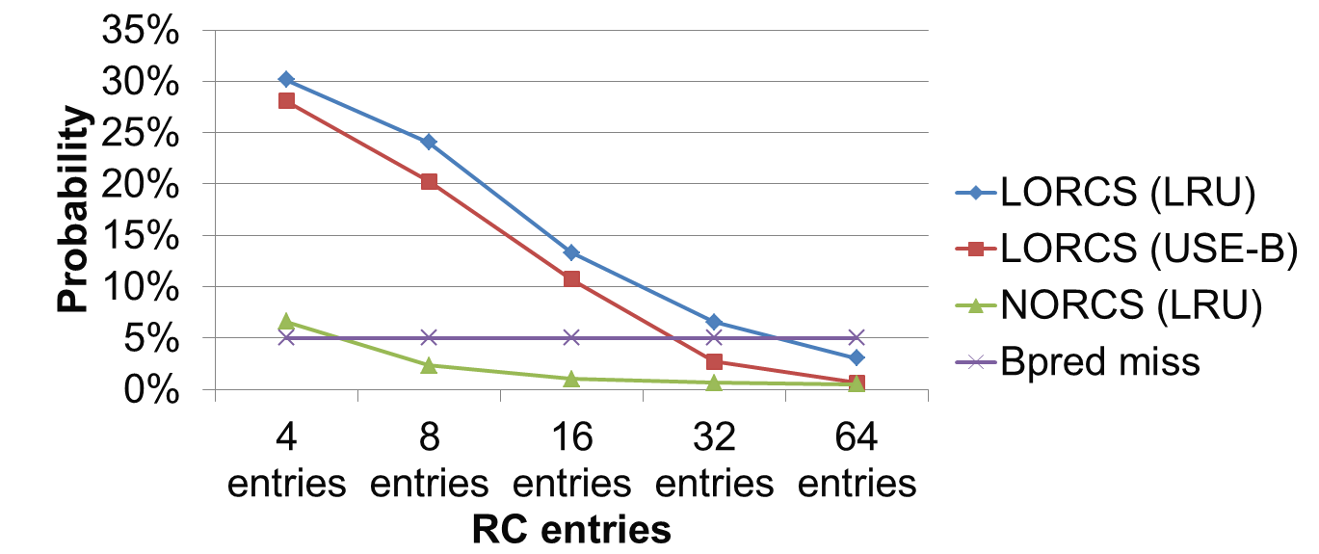
Average probabilities of stalls and branch prediction miss
In NORCS, the probabilities of stalls are very row
In LORCS, the probabilities of stalls are much higher than branch miss penalty in the models with 4,8, and 16 entries RC
Notes:
This graph shows probabilities of stalls of each model
and branch prediction misses.
The horizontal axis shows RC entries, and the vertical axis shows probability.
In NORCS, the probabilities of stalls are very row.
In LORCS,
The probability of RC miss penalties are much higher than
Branch miss penalties in the models with 4, 8, and 16 entries.
In these situations, NORCS will be faster than LORCS as described before.

Slide 39
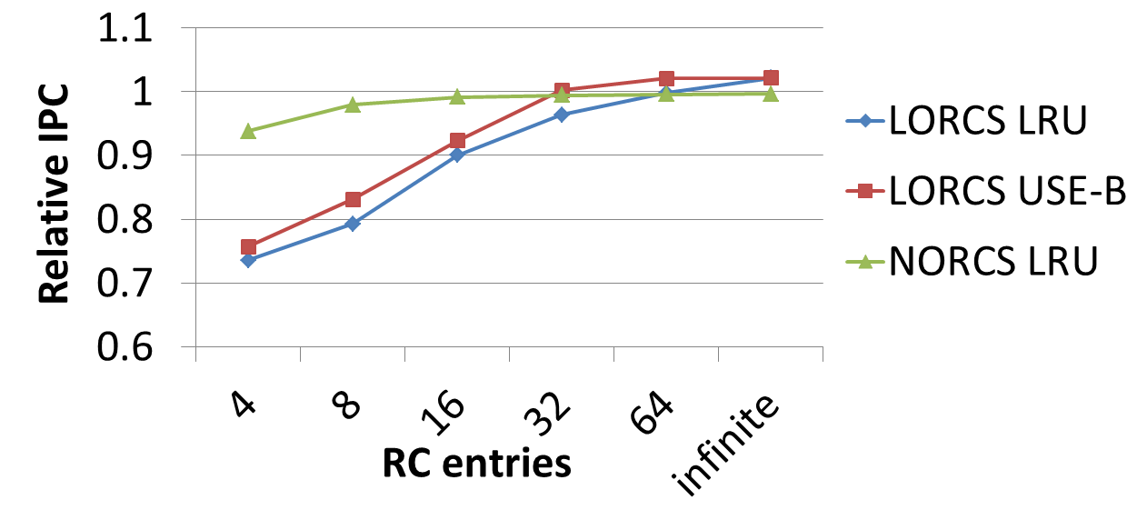
Average relative IPC All IPCs are normalized by that of PRF
In LORCS, IPC degrades significantly in the models with 4,8,and 16 entries RC
In NORCS, IPC degradation is very small
LORCS with 64 entries LRU RCs and NORCS with a 8 entries RC are almost same IPC …But
Notes:
This graph shows average relative IPC.
All IPCs are normalized by that of the PRF model.
In LORCS, IPC degrades significantly in the models with 4,8, and 16 entries RC
In NORCS, IPC degradation is very small.
LORCS with a 64 entries RC and NORCS with a 8 entries RC show almost same
IPCs

Slide 40
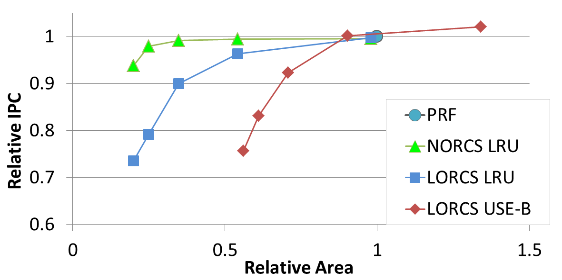
Trade-off between IPC and area RC entries：4, 8, 16, 32, 64
Area -75.1%
NORCS with 8entries RC :
Area is reduced by 75.1% with only 2.1% IPC degradation from PRF
Notes:
This graph shows the relative IPC per circuit areas.
All areas are normalized by that of the PRF model.
Each data point of the line in this figure
indicates a value of the model with a 4-, 8-, 16-, 32-, and
64- entries register cache from left to right.
In NORCS with 8 entries RC,.
The area is reduced by 75.1% with only 2.1% IPC degradation from PRF model.

Slide 41
Trade-off between IPC and area RC entries：4, 8, 16, 32, 64
Area -72.4%
IPC 18.7%
NORCS with 8entries RC :
Area is reduced by 72.4% from that of LORCS-LRU with same IPC
IPC is improved by 18.7% from that of LORCS-LRU with same area
Notes:
There is no significant difference of IPCs between
NORCS with 8-entry LRU register cache and LORCS with
64-entry register cache of LRU policy,
However, the area of the model of
NORCS is reduced by 72.4% from the model of LORCS.
NORCS and LORCS with 8 entries LRU register cache show
the same areas. However, the model of
NORCS improves IPC by 18.7% from the model of LORCS.
The models of LORCS USE-B have large areas
Because their use-predictors for replacement are very large.

Slide 42
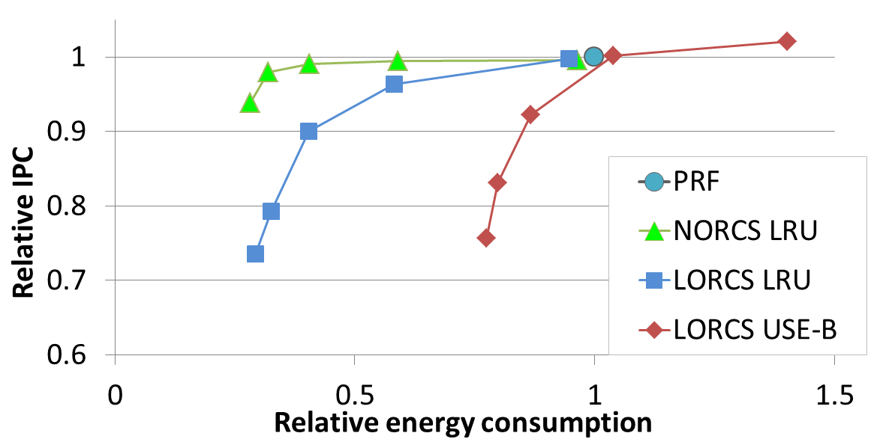
Trade-off between IPC and energy consumption RC entries：4, 8, 16, 32, 64
Energy -68.1%
IPC 18.7%
Our proposal（NORCS with 8entries RC ）:
Energy consumption is reduced by 68.1% with only 2.1% IPC degradation
Notes:
This graph shows the relative IPC per energy consumption like the previous graph.
This graph shows the same tendency as that of areas.
The energy consumption of NORCS is reduced by 68.1% from PRF % with only 2.1% IPC degradation

Slide 43
Conclusion
A large RF causes many problems
Especially energy and heat are serious
A register cache was proposed to solve these problems
Miss penalties degrade IPC
NORCS： Non-latency-Oriented Register Cache System
We solve the problems with a “not fast” register cache
Our method overcomes methods with “fast” register caches
Circuit area is reduced by 75.1% with only 2.1% IPC degradation
Notes:
A large RF causes many problems
Area, latency, energy, and heat …
A register cache was proposed to solve these problems
Miss penalties degrade IPC
We solve the problems with a “not fast” register cache
Our method overcomes methods with a “fast” register cache
Evaluations show circuit area is reduced to 24.9% and
IPC degradation is no more than 2.1%

Slide 44
Appendix

Slide 46
Onikiri2
Implementation
Abstract pipeline model for OoO superscalar processor
Instruction emulation is performed in exec stages
Incorrect result for incorrect scheduling
Features
Written in C++
Support ISA : Alpha and PowerPC
Can execute all the programs in SPEC 2000/2006
Notes:
Onikiri2 has abstract pipeline model for OoO superscalar processor,
so it supports any types of OoO superscalar processors.
Instruction emulation is performed in exec stages.
Many simulator, such as SimpleScalar and Simics, Instruction emulation is performed in fetch stages.
Incorrect scheduling cause incorrect result, thus bugs are easily detected.
Onikiri2 is written in C++.
It support Alpha and PowerPC ISA.
it can execute all the programs in SPEC 2000/2006.

Slide 47
Write
reg num/data
Arbiter
Main register file
hit/miss
Out of instruction pipeline
Read
reg num
Write
reg num/data
ALU
Register cache

Slide 48
Write
reg num/data
Write
buffer
Arbiter
Main register file
hit/miss
Tag array
Data array
Read
reg num
Added latches
Write
reg num/data
Write data
ALU
Register cache

Slide 49
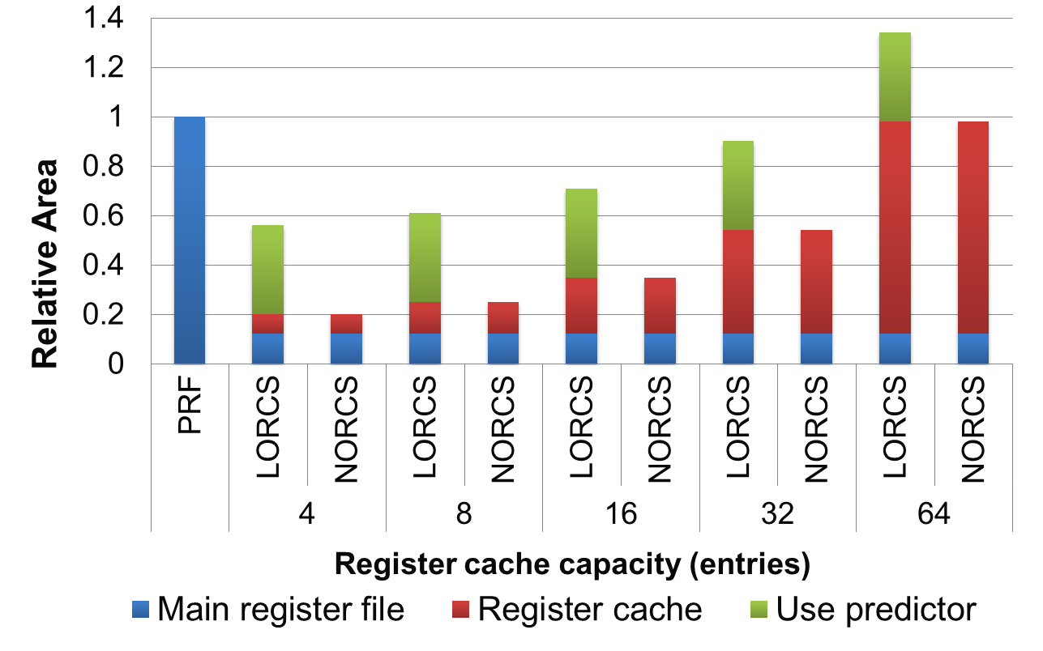
Relative area
80.1%
Notes:
This graph shows the circuit areas relative to that of PRF model.
The areas include those of the register
cache, main register file and use-predictor.
In NORCS, the total area of the main register file and the
register cache is reduced to 19.9%, 24.9%, 34.7%,

Slide 50
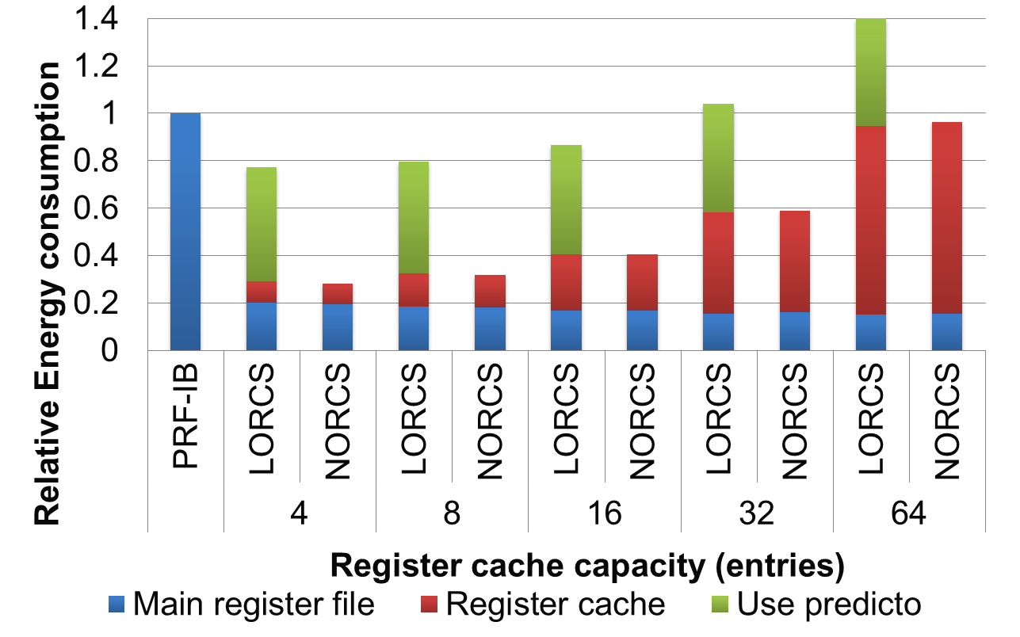
Relative energy consumption

Slide 51
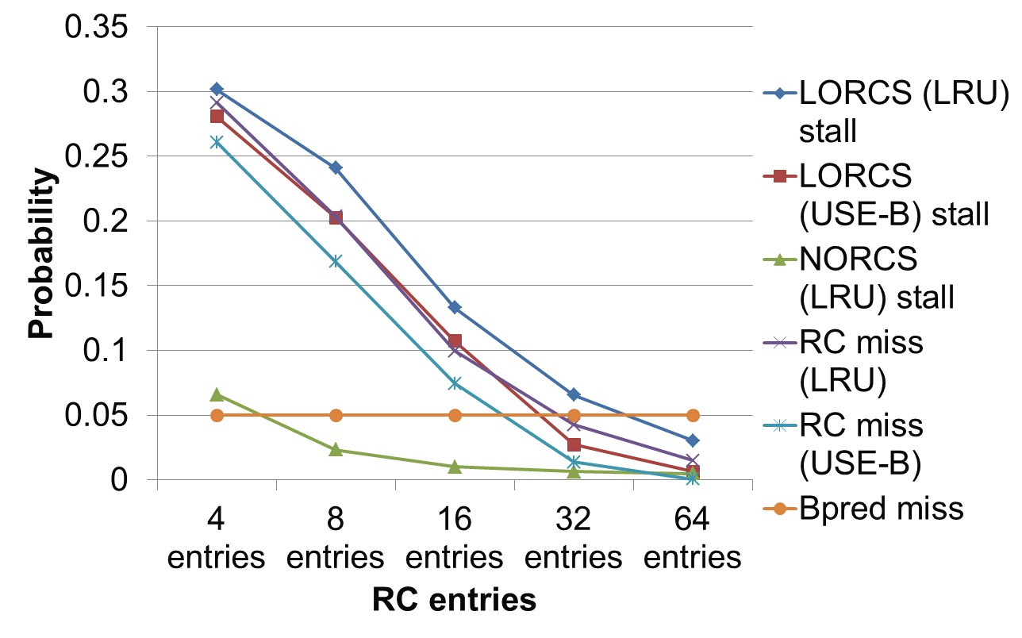
Probabilities of RC miss / penalty / Branch miss

